Slide 1

Xamarin.Forms Shell: A new way to create mobile apps
ALEJANDRO RUIZ
Microsoft MVP
alejandro@alejandroruizvarela.com

Slide 2
Xamarin.Forms Shell
Is a container for applications, that provides fundamental UI features that most applications require, leaving you to focus on the application's core workload.
Shell applications are provided with the following functionality:
A single place to describe the visual structure of an application
A common navigation user interface.
A navigation service with deep linking.

Slide 3
Xamarin.Forms Shell - Structure
Top Level of Navigation:
Flyout
Bottom Tab Bar
Top Tab Bar

Slide 4
Adding Forms Shell to Your Project
iOS & Android, add experimental flag into MainActivity and AppDelegate:
global::Xamarin.Forms.Forms.SetFlags("Shell_Experimental");
Set your shell into your Application’s MainPage property:
MainPage = new YourShell();

Slide 5
Xamarin.Forms Shell Hierarchy
ShellItem
One or more items in the flyout. Every ShellItem is a child of a Shell
ShellSection
Grouped content, navigable by bottom tabs. Every ShellSection is a child of a ShellItem.
ShellContent
The ContentPage instances in your application, which are navigable by top tabs. Every ShellContent is a child of a ShellSection.

Slide 6
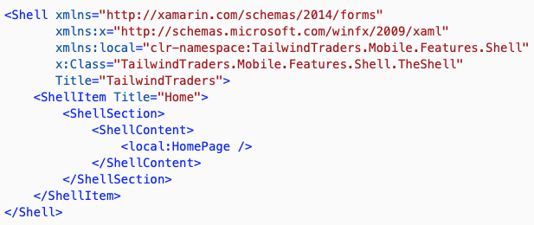

Slide 7
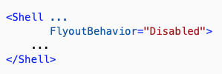
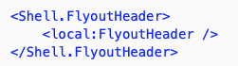
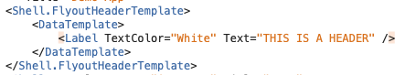
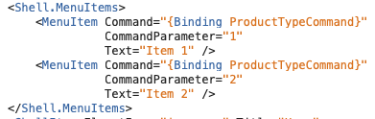
Flyout - Structure
Behavior
Header & HeaderTemplate
Menu items

Slide 8
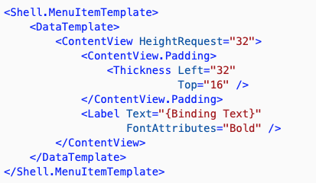
FlyoutHeaderBehavior
CollapseOnScroll
Fixed
Scroll
Custom Menu items Template

Slide 9
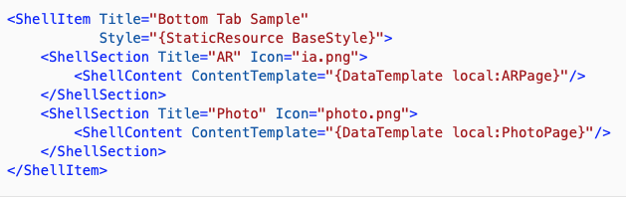
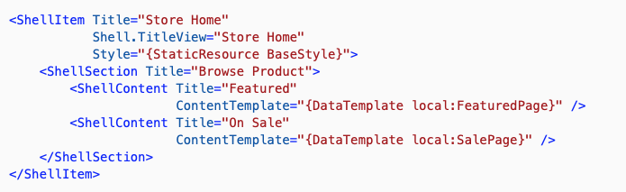
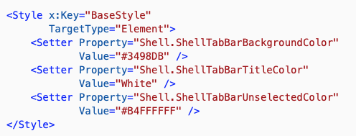
Tabs - Structure
Style

Slide 10
Navigation
Shell includes a URI-based navigation experience. URIs provide an improved navigation experience that permits navigation to any page in the application, without having to follow a set navigation hierarchy. In addition, it also provides the ability to navigate backwards without having to visit all of the pages on the navigation stack.

Slide 11
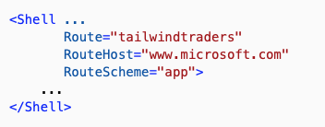
Adding Navigation
1) URI Based Navigation
2) Register your pages:
Routing.RegisterRoute("myawesomepage", typeof(HomePage));
3) Navigate to page and query string params:
Shell.CurrentShell.GoToAsync($"app:///home/tabs/favorites/myfavorites?text={id}", true);

Slide 12
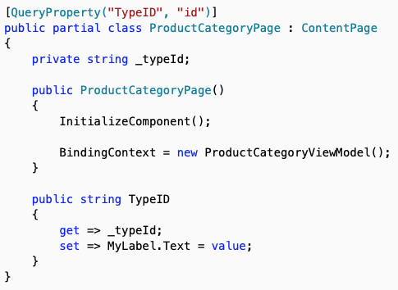
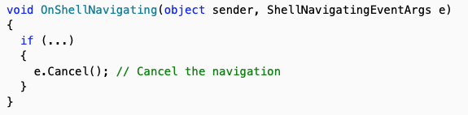
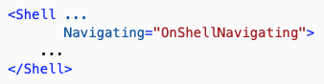
Adding Navigation
4) Intercept Params
5) Handle Navigation Actions:

Slide 13
Questions?
Alejandro Ruiz
Microsoft MVP: Developer Technologies
Xamarin.Forms Shell: A new way to create mobile apps
DEMO: https://github.com/AlejandroRuiz/XamarinFormsShellDemo
alejandro@alejandroruizvarela.com
https://alejandroruizvarela.blogspot.mx
@alejandroruizva

